Slide 1
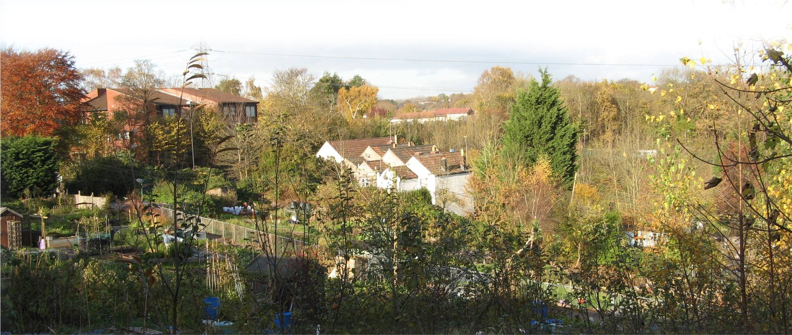
Design Note: add a nice high resolution image of the GP practice behind the logos like shown.
[INSERT GP SURGERY NAME HERE] Information for carers
[INSERT GP SURGERY WEBSITE ADDRESS HERE] | www.carersbsg.org.uk
Notes:
Title Slide

Slide 2
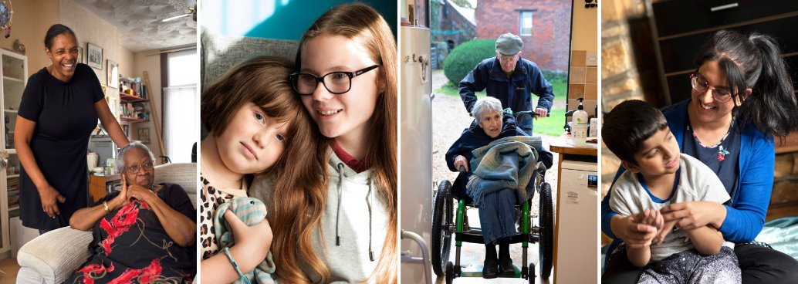
Do you look after someone who could not manage without your support and do not receive any payment for it?
If so, you may be a Carer
www.carerssupportcentre.org.uk
Notes:
Slide 2

Slide 3
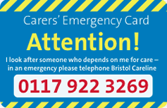
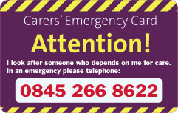
Support for Carers at [Insert GP Surgery Name Here]
Help to get the Carers Emergency Card – this ensures that if you had an accident the person you care for is kept safe
Help to get a Carers Assessment to look at what support you need with your caring role.
Information on what other support is available for carers locally and nationally.
www.carerssupportcentre.org.uk
Notes:
Slide 3

Slide 4
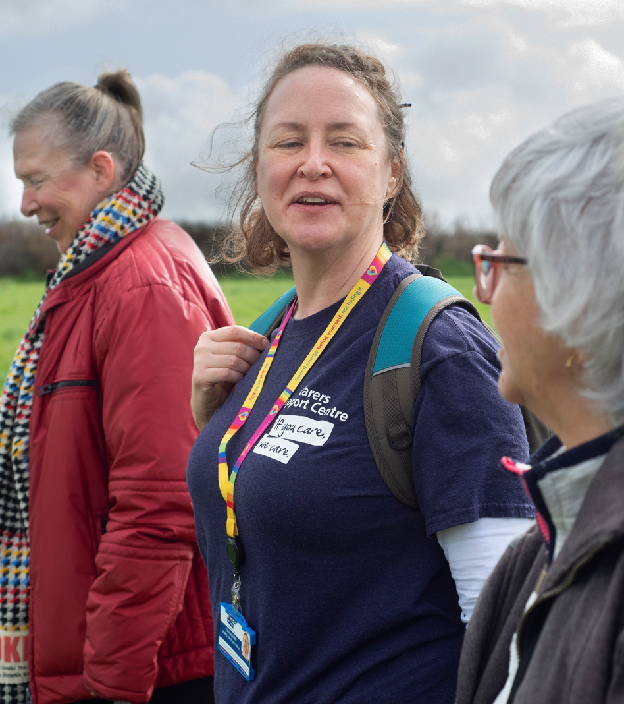
Support for Carers at [Insert GP Surgery Name Here]
Flexible appointments – for carers who would otherwise be unable to see a doctor because of their caring role.
A free flu vaccination
A referral for a carers assessment where appropriate. This assessment can result in you receiving money to take a break from caring.
Carers Support run Walk and Talk groups for carers all around Bristol and South Gloucestershire
www.carerssupportcentre.org.uk
Notes:
Slide 4

Slide 5
Carer Surgeries at [Insert GP Surgery Name Here]
Book an appointment at our carer surgery so you can get information, advice and support about what help is available to you from a Carers Support Worker.
[insert GP name here] carer surgeries is on: The 1st/2nd/3rd/4th [insert month here] of every month from [time start] to [time end]. How to book: To book an appointment ask at reception or speak to your GP to find out more.
Notes:
Slide 5

Slide 6
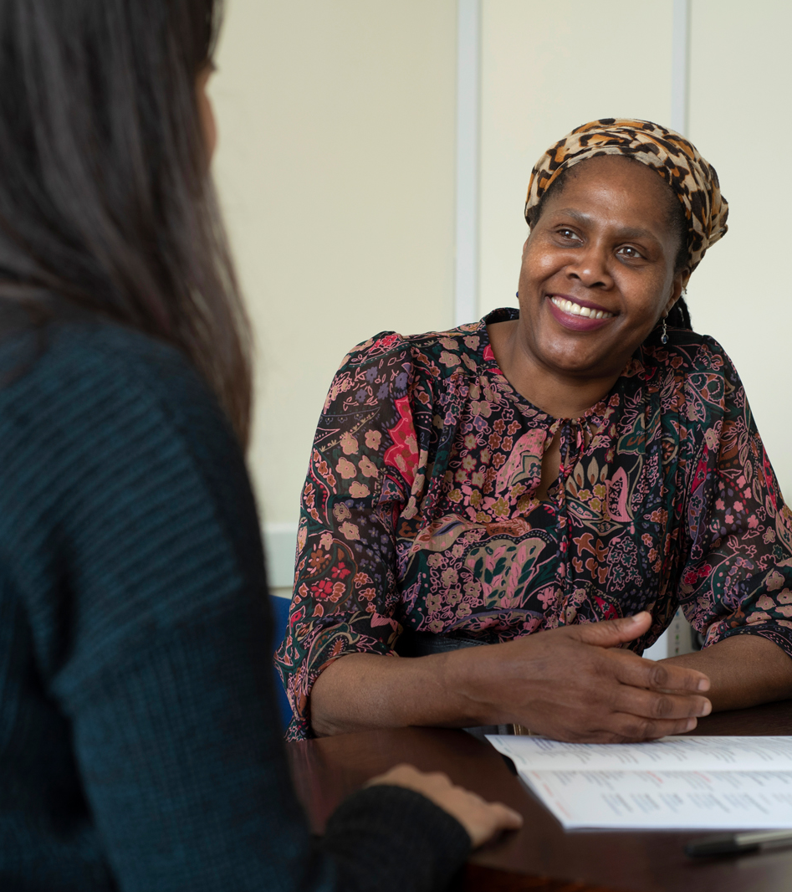
How do I get support?
Just ask at reception to be put on our carers register and to be contacted by Carers Support
You can also contact CarersLine for confidential telephone information, support and advice about health and social care services. CarersLine: 0117 965 2200 Opening times: Mon – Thurs: 10am – 1pm & 2pm – 4pm Fri: 10am – 1pm An answerphone operates outside these hours.
Notes:
Slide 6

